Slide 1
Function Overloading
IEEE-Computer Society

Slide 2
Finding Gross Pay
Three are three types of employees in Indian railways. They are regular, daily wages and consolidated employees. Gross Pay for the employees are calculated as follows:
regular employees - basic + hra + % of DA * basic
Daily wages – wages per hour * number of hours
Consolidated – fixed amount

Slide 3
PAC - Finding Gross pay
Input | Output | Logic Involved
Components for calculating gross pay | Gross pay | Based on type of employees – Calculate gross pay

Slide 4
Writing Functions
Same function name for all three type of employees
More meaningful and elegant way of doing things
I prefer the name - calculate_Gross_Pay for all types of employees

Slide 5

Look alike but exhibit different characters

Slide 6
Polymorphism
Refers to ‘one name having many forms’, ‘one interface doing multiple actions’.
In C++, polymorphism can be either
static polymorphism or
dynamic polymorphism.
C++ implements static polymorphism through
overloaded functions
overloaded operators

Slide 7
Overloading
Overloading – A name having two or more distinct meanings
Overloaded function - a function having more than one distinct meanings
Overloaded operator - When two or more distinct meanings are defined for an operator

Slide 8
Function Overloading
C++ enables several functions of the same name to be defined, as long as they have different signatures.
This is called function overloading.
The C++ compiler selects the proper function to call by examining the number, types and order of the arguments in the call.

Slide 9
Overloaded functions are distinguished by their signatures
Signature - Combination of a function’s name and its parameter types (in order)
C++ compilers encodes each function identifier with the number and types of its parameters (sometimes referred to as name mangling or name decoration) to enable type-safe linkage.

Slide 10
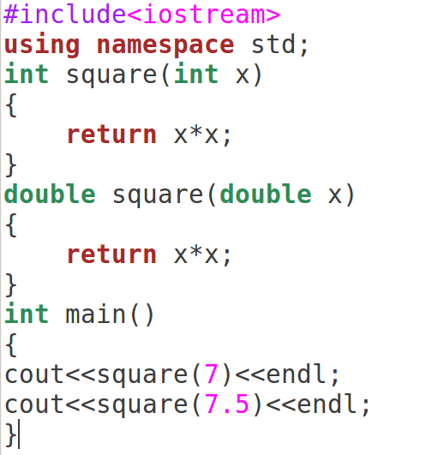

Slide 11
Signature of a Function
A function’s argument list (i.e., number and type of argument) is known as the function’s signature.
Functions with Same signature - Two functions with same number and types of arguments in same order
variable names doesn’t matter. For instance, following two functions have same signature.
void squar (int a, float b); //function 1
void squar (int x, float y);

Slide 12
Following code fragment overloads a function name prnsqr( ).
void prnsqr (int i);
//overloaded for integer #1
void prnsqr (char c);
//overloaded for character #2
void prnsqr (float f);
//overloaded for floats #3
//overloaded for floats #3
void prnsqr (double d);
//overloaded for double floats #4

Slide 13
void prnsqr (int i)
{
cout<<“Integer”<<i<<“’s square is”<<i*i<<“\n”;
}
void prnsqr (char c);
{
cout <<“No Square for characters”<<“\n”;
}
void prnsqr (float f)
{
cout<<“float”<<f <<“’s square is”<<f *f<<“\n”;
}
void prnsqr (double d)
{
cout <<“Double float”<<d<<“’s square is”<<d*d<<“\n’;
}

Slide 14
Resolution by Compiler when it sees second function with same name
Signature of subsequent functions match previous function’s, then the second is treated as a re-declaration of the first - Error
Signatures of two functions match exactly but the return type differ, then the second declaration is treated as an erroneous re-declaration of the first
For example,
float square (float f);
double square (float x);
// Differ only by return type so erroneous re-declaration
//error

Slide 15
If the signature of the two functions differ in either the number or type of their arguments, the two functions are considered to be overloaded.

Slide 16
CALLING OVERLOADED FUNCTIONS
Overloaded functions are called just like other functions. The number and type of arguments determine which function should be invoked.
For instance consider the following code fragment:
prnsqr (‘z’);
prnsqr (13);
prnsqr (134.520000012);
prnsqr (12.5F);

Slide 17
Steps Involved in Finding the Best Match for a function call
A call to an overloaded function is resolved to a particular instance of the function, there are three possible cases, a function call may result in:
One match - A match is found for the function call.
No match - No match is found for the function call.
Ambiguous Match - More than one defined instance for the function call.

Slide 18
Exact Match
For example, there are two functions with same name afunc:
void afunc(int);
void afunc(double);
The function call
afunc(0);
is matched to void afunc(int); and compiler invokes corresponding function definition
as 0 (zero) is of type int
//overloaded functions
//exactly match. Matches afunc(int)

Slide 19
2. A match through promotion
If no exact match is found, an attempt is made to achieve a match through promotion of the actual argument.
Recall that the conversion of integer types (char, short, enumerator, int) into int - integral promotion.

Slide 20
For example, consider the following code fragment:
void afunc (int);
void afunc (float);
afunc (‘c’);
Will invoke afunc(int)
//match through the promotion; matches afunc (int)

Slide 21
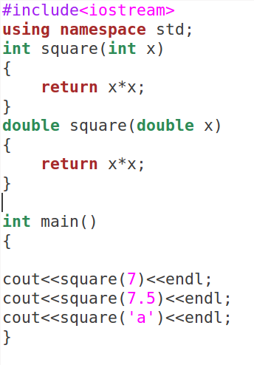
Compiler resolves square (‘a’) to square(int)

Slide 22
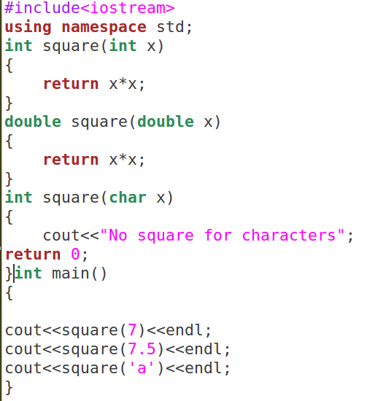
Compiler resolves square (‘a’) to square(char)

Slide 23
3. A match through application of standard C++ conversion rules
If no exact match or match through a promotion is found, an attempt is made to achieve a match through a standard conversion of the actual argument. Consider the following example,
void afunc (char);
afunc (471);
//match through standard conversion matches afunc (char)

Slide 24
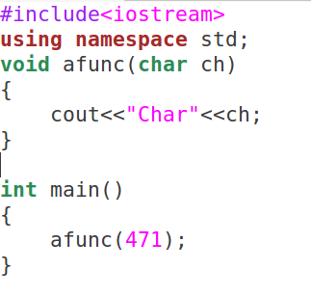
‘int’ argument is converted to char

Slide 25
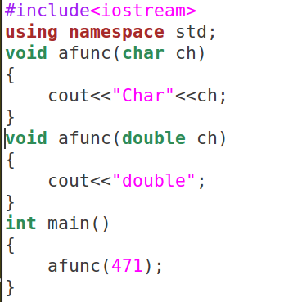
Error ambiguous call

Slide 26
4. A match through application of a user-defined conversion
If all the above mentioned steps fail, then the compiler will try the user-defined conversion in the combinations to find a unique match.
Member functions can also be overloaded

Slide 27
Default Arguments Versus Overloading
Using default argument is also overloading, because the function may be called with an optional number of arguments.
For instance, consider the following function prototype:
float amount (float principal, int time=2, float rate=0.08);

Slide 28
Now this function may be called by providing just one or two or all three argument values. A function call like as follows:
cout<<amount (3000);
will invoke the function amount() with argument values 3000, 2, and 0.08 respectively. Similarly a function call like
cout <<amount (3000,4);
Will invoke amount() with argument values 3000, 4 and 0.08
cout <<amount (2500,5,0.12);
Will invoke amount() with argument values 2500, 5, and 0.12 respectively

Slide 29
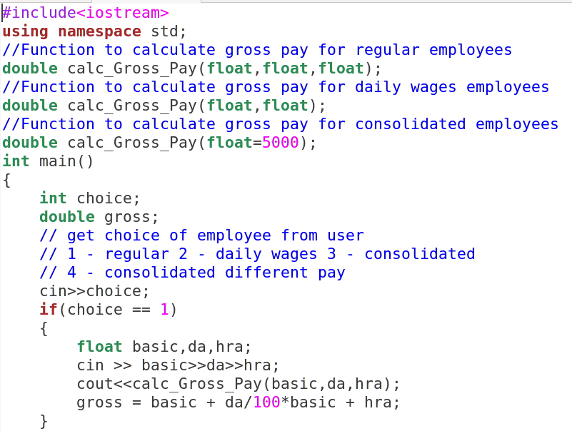

Slide 30
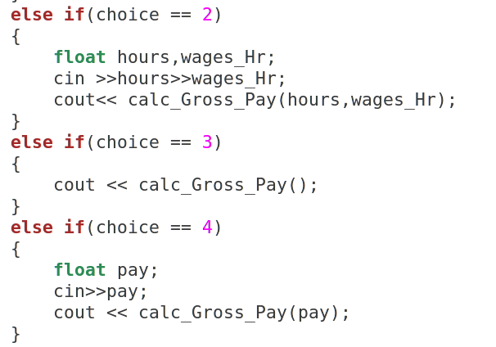

Slide 31
